Slide 1
Systems and Internet Security Technologies
Lecture 4
8 Oct 2025
تجميع وإعداد
أحمد حسين

Slide 2
Lecture 4
Open Redirects

Slide 3

Reference:
Chapter 7
Open Redirects

Slide 4
Mechanism
Many sites automatically redirects users between its web pages to save user’s time and improve user’s experience.
If an attacker succeeds in modifying a URL redirect parameter, the victim will end up landing on an offsite page.
It’s easy to trick a user into clicking on a link that starts with a familiar domain while it redirects to a malicious page.
http://e-books.helwan.edu.eg/login?redirect=http://e-books.helwan.edu.eg/hufe/..
http://e-books.helwan.edu.eg/login?redirect=https://attacker.com

Slide 5
Escalating open redirect attacks
The victim is tricked into clicking the link prepared by the attacker with an open redirect attack.
Once the victim opens a malicious page thinking it is legitimate, the attacker could employ social engineering techniques to steal victim’s credentials for the target legitimate website.

Slide 6
Referrer-based Open Redirect
Referrers indicate request origin (URL that linked to the current page).
An HTTP request header.
Automatically generated by browsers.
If, the targeted website uses a referrer-based redirect system and the victim was tricked into visiting the targeted website via a link within the attacker’s page, then the victim’s browser will automatically redirect to attacker’s site after the website visit.

Slide 7
How to prevent open redirect attacks?
URL validators: Does the URL point to a legitimate page?
There are two implementations:
  Blocklist (URL contains suspicious indicators?)
  Allowlist (URL hostname is in the allowlist?)

Slide 8
Why open redirects are so prevalent?
URL validation is not a simple task.
URL Parsing and decoding is challenging.
So, it’s hard for URL validators to correctly identify hostname portions of suspected URLs.
Attackers usually find ways to bypass URL validators.

Slide 9
How to find open redirect vulnerabilities?
Search for URL parameters commonly used for redirects. For example:
  https://example.com/login?redirect=https://example.com/dashboard
  https://example.com/login?redir=https://example.com/dashboard
  https://example.com/login?next=https://example.com/dashboard
  https://example.com/login?forward=/dashboard
  https://example.com/login?n=dashboard
Search proxy’s HTTP history for candidate parameters containing absolute or relative URLs.

Slide 10
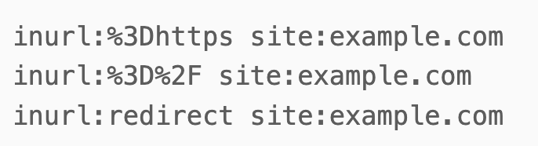
How to find open redirect vulnerabilities? (cont.)
Use Google Dorks.
  For example:
Note:
%3D represents the `=` equal sign in URL encoding.
%2F represents the `/` slash character in URL encoding.

Slide 11
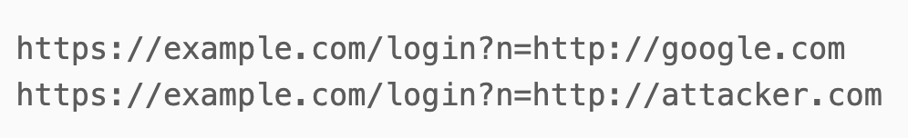
Manually testing for open redirect
Test each discovered redirection parameter as follows:
  Insert a website of your choice as the redirect argument. For example:
  Does the target website redirect to the chosen website?
  Redirection could happen immediately or after user interaction
  (e.g., login)

Slide 12
Manually testing for referrer-based open redirects
Host the following simple web page in your own server.
Visit the target website via the above page by clicking the link.
Have you been automatically redirected to your page?

Slide 13



Open-Redirect Protection Issues
A browser redirection depends on how it identifies the following URL components:
URL validator should predict how the browser identifies URL components. Then, reject offsite redirections.
Redirection location is dictated by the hostname portion of the URL (as seen by the browser).
However, URLs are sometimes malformed:
  Having out of order components.
  Containing undecodable characters.
  Having missing components.
  Having extra components.
Inconsistent URL handling across different browsers!

Slide 14


Evading Open-Redirect Protection
Abusing browser autocorrect features
Exploiting flawed validator logic
Using data URLs
Exploiting URL decoding
  Double decoding
  Non-ASCII characters
Combining exploit techniques

Slide 15
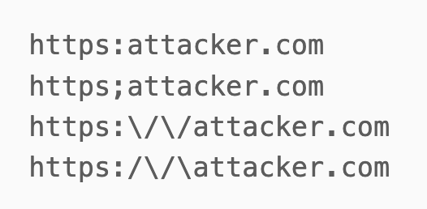
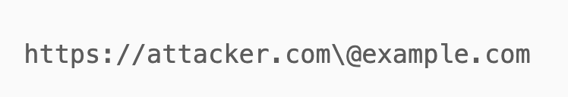
Abusing browser autocorrect features
Browser autocorrect features try to fix user typos, such as,
Modern browsers usually replace backslashes with forward slashes.
If the URL validator doesn’t treat backslashes as a path separator as well, an attacker can use the following URL to trick the validator.

Slide 16


Abusing browser autocorrect features (cont.)
Browser
URL Validator
Browser autocorrects \ into /
No autocorrection
Redirects to https://attacker.com
with @example.com as the path!
Evaluates hostname as example.com
and username as attacker.com\
Thus, redirection is incorrectly allowed

Slide 17
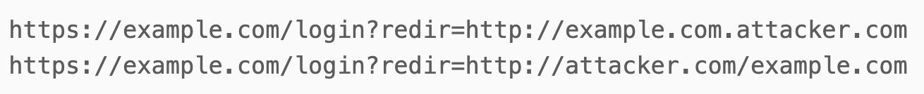
Exploiting flawed validator logic
If a URL validator merely looks for site’s domain name within in the redirection argument, the following URLs will trick such validator, why?
An attacker could bypass this validator by creating either a subdomain or a directory with the site’s domain name!

Slide 18
Exploiting flawed validator logic (cont.)
What if the validator allows only redirections starting and ending with a domain name in the allowed list?
Could you bypass this protection?
Analyze the following URL:
Covering all edge cases with a custom-built validator is not trivial!

Slide 19
Using Data URLs
The above script forces the browser to redirect to the supplied location.
Notes:
Obfuscated URLs

Slide 20



Exploiting URL decoding
Applicable whenever there is a discrepancy between the way URL decoding is performed by browsers and validator.
Double encoding
URL encoded
double encoded
triple encoded
N.B.
‘/’ → %2f (forward slash)
‘%’ → %25 (percentage)

Slide 21


Double Encoding
Incomplete URL decoding
Complete
URL decoding
https://example.com%2f@attacker.com
https://example.com/@attacker.com
Redirects to attacker.com
Incorrectly allowed
Notes:
Validator double decodes URLs while browser doesn’t.

Slide 22

Double Encoding (cont.)
Complete
URL decoding
Incomplete URL decoding
https://attacker.com/@example.com
https://attacker.com%2f@example.com
Redirects to attacker.com
Incorrectly allowed
Notes:
Browser double decodes URLs while validator doesn’t.

Slide 23

Non-ASCII Characters
Browsers decode %ff
into ?
Validator decodes %ff into character ÿ
https://attacker.com?.example.com
https://attacker.comÿ.example.com
Redirects to attacker.com
Incorrectly allowed
.example.com is a query
attacker.comÿ is the subdomain
example.com is the domain
Notes:
%ff is the character ÿ

Slide 24
Combining exploit techniques
The following URL would defeat more sophisticated layered defenses.
The above URL will trick validators looking for site’s domain name at the beginning or ending of the redirection URL.
At the same time, the above URL will trick any validator which overdecodes the URL.

Slide 25

Escalating the attack
Open redirect could add credibility to phishing attacks! How?
Step 1:
An attacker sends a seemingly legitimate URL that stealthily redirects to a malicious page. For example,
Step 2:
The victim clicks the link, visits the legitimate website, enters his credentials, and then redirected to a fake login page.
Step 3:
The fake login page, that mimics the legitimate login page, would trick the victim into logging again.
Step 4:
The victim will provide credentials to the attacker’s site thinking that he has not entered them correctly in the first attempt.
Step 5:
Redirect the victim back to the legitimate site.

Slide 26
Escalating the attack
Open redirect could help an attacker bypass allowlists for conducting a Server-Side Request Forgery (SSRF) attack.
Attackers could use open redirects to steal credentials and Open Authentication (OAuth) tokens.

